Slide 1

NATIONAL UNIVERSITY OF MODERN LANGUAGES
Faculty of Engineering and Computing
Department of Software Engineering

Slide 2

SOFTWARE DESIGN AND ARCHITECTURE
LECTURE NO. 6
Introduction to Software Engineering Design
Course Instructor: | Mr. Ahsan Arif
 | Lecturer Department of Software Engineering NUML Islamabad
Date: March 18, 2024
Software Engineering Design: Theory and Practice

Slide 3
LECTURE CONTENTS
  Introduction to Sequence Diagram (Process View)
    What is sequence diagram?
    What are the different parts of sequence diagram?
      Message passing and its types
      Loop and condition in sequence diagram
      Frames in sequence diagram
    How to draw sequence diagram?
    Example of drawing sequence diagram with Case Study
Date: March 18, 2024
Software Engineering Design: Theory and Practice

Slide 4
UML – SEQUENCE DIAGRAM
Introduction to SEQUENCE diagram
Sequence diagram is also called an event diagram or event scenario.
The UML diagram which shows an interaction between objects arranged in a time sequence is a Sequence Diagram.
Sequence diagram
=
Event diagram or Event scenario
Interaction Diagram
Collaboration Diagram
Sequence Diagram
Date: March 18, 2024
Software Engineering Design: Theory and Practice

Slide 5
What is SEQUENCE diagram?
The sequence diagram is an interaction diagram that shows details on how operations are carried out like what messages are sent and when.
Sequence Diagram illustrates
  how the different parts of a system interact with each other to carry out a function, and
  the order in which the interactions occur when a particular use case is executed.
Date: March 18, 2024
Software Engineering Design: Theory and Practice

Slide 6
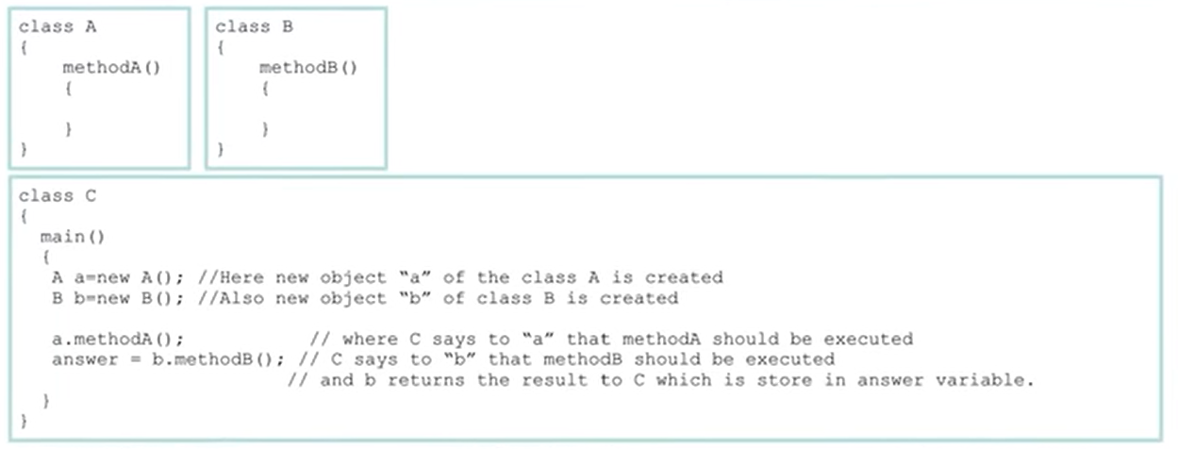
SEQUENCE – Diagram
Objects of the classes communicate by sending and receiving messages
Date: March 18, 2024
Software Engineering Design: Theory and Practice

Slide 7
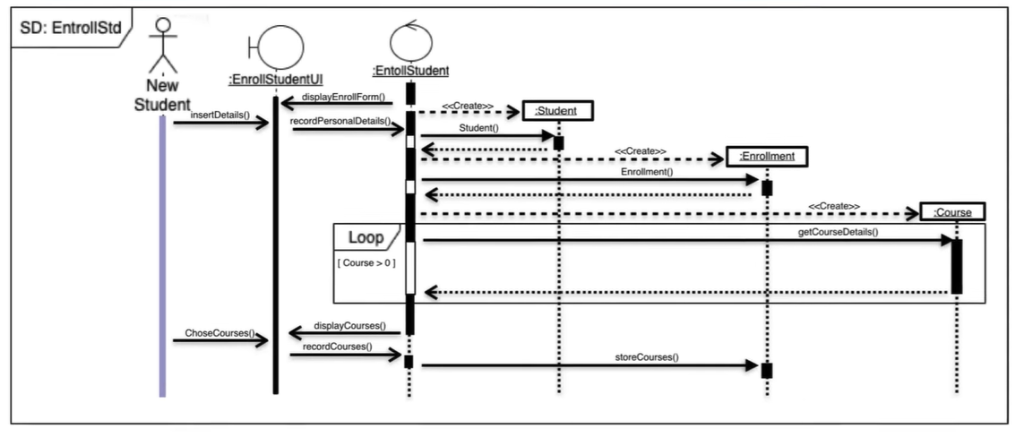
SEQUENCE – Diagram
A sequence diagram is structured in such a way that it represents a timeline that begins at the top and descends gradually to mark the sequence of interactions. Each object has a column and the messages exchanged between them are represented with arrows.
Date: March 18, 2024
Software Engineering Design: Theory and Practice

Slide 8
Different parts of SEQUENCE Diagram
Dimension:
  A sequence diagram is drawn in two dimensions, Horizontal and Vertical.
    Object Dimension
    Time Dimension
Date: March 18, 2024
Software Engineering Design: Theory and Practice

Slide 9
Different parts of SEQUENCE Diagram
Dimension:
  A sequence diagram is drawn in two dimensions, Horizontal and Vertical.
    Object Dimension
    Time Dimension
Date: March 18, 2024
Software Engineering Design: Theory and Practice

Slide 10
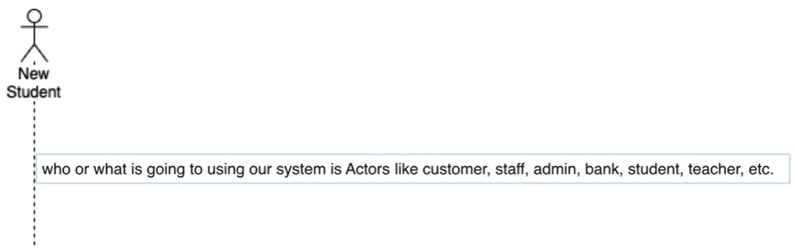
Different parts of SEQUENCE Diagram
Actor:
  Anyone how use to perform a certain function in the system is actors.
Date: March 18, 2024
Software Engineering Design: Theory and Practice

Slide 11
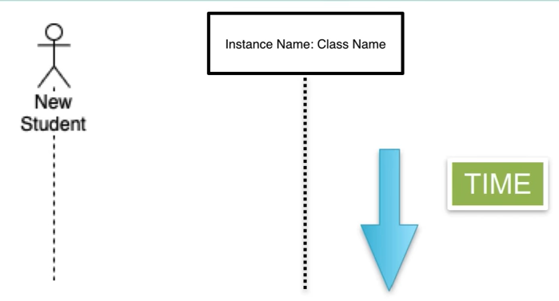
Different parts of SEQUENCE Diagram
Lifeline:
  A lifeline represents an individual participant in the interaction.
Date: March 18, 2024
Software Engineering Design: Theory and Practice

Slide 12
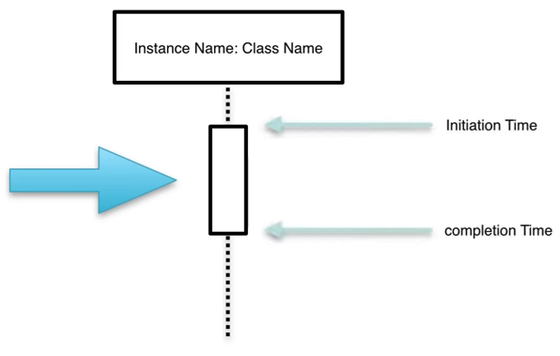
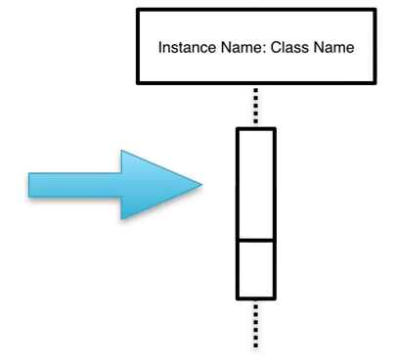
Different parts of SEQUENCE Diagram
Activation:
  A thin rectangle box on a lifeline represents the time needed for an object to complete a task.
Date: March 18, 2024
Software Engineering Design: Theory and Practice

Slide 13
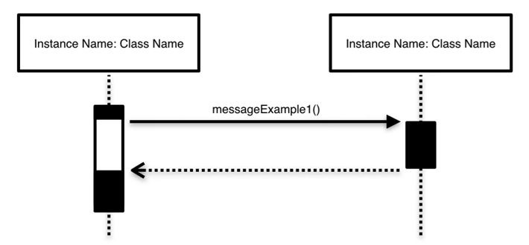
Different parts of SEQUENCE Diagram
Message:
  A message defines a particular communication between Lifelines of an interaction.
  5.1. Synchronous Messages
  This message is used when a sender must wait for a response to a message before it continues.
Date: March 18, 2024
Software Engineering Design: Theory and Practice

Slide 14
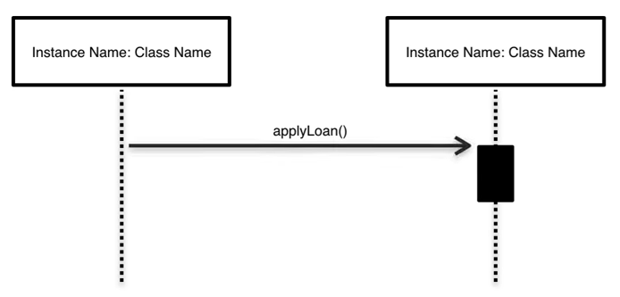
Different parts of SEQUENCE Diagram
Message:
  5.2. Asynchronous Messages
  An asynchronous message does not wait for a response from the receiver before the sender continues.
Date: March 18, 2024
Software Engineering Design: Theory and Practice

Slide 15
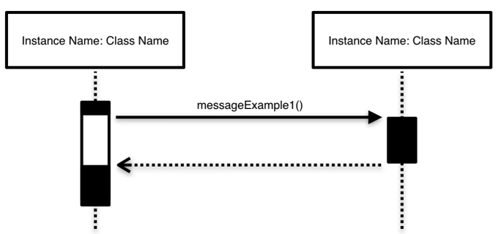
Different parts of SEQUENCE Diagram
Message:
  5.3. Return Message
  A return message is used to indicate that the message receiver is done processing the message and is returning control over to the message caller.
Date: March 18, 2024
Software Engineering Design: Theory and Practice

Slide 16
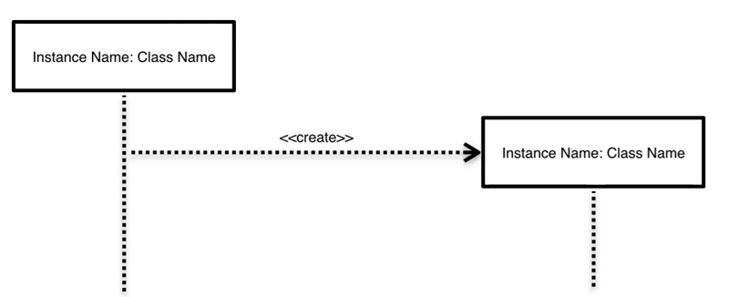
Different parts of SEQUENCE Diagram
Message:
  5.4. Create Message
  To represent the new object created in the process of the execution, create a message is used.
Date: March 18, 2024
Software Engineering Design: Theory and Practice

Slide 17
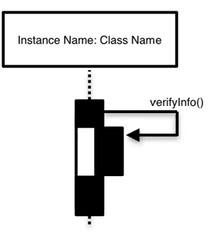
Different parts of SEQUENCE Diagram
Message:
  5.5. Reflexive Messages
  Sometimes an object needs to communicate with the same class methods.
Date: March 18, 2024
Software Engineering Design: Theory and Practice

Slide 18
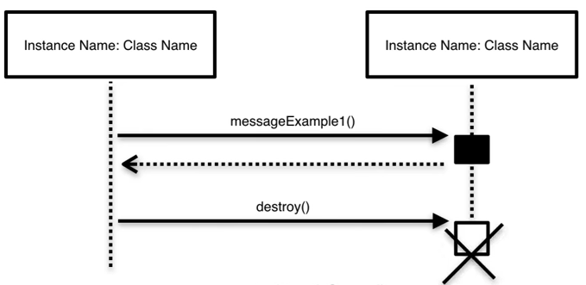
Different parts of SEQUENCE Diagram
Message:
  5.6. Object Destruction
  As soon as the object does not need any more in further process, object destruction is called which is deleting the object.
Date: March 18, 2024
Software Engineering Design: Theory and Practice

Slide 19
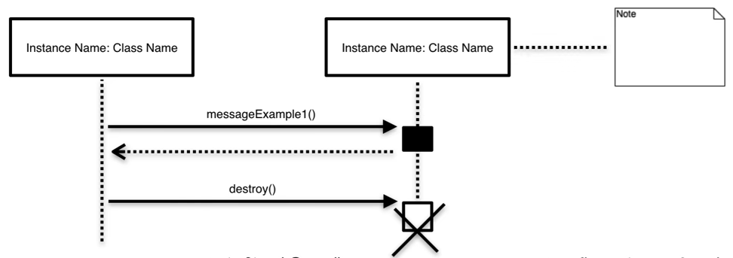
Different parts of SEQUENCE Diagram
Message:
  5.7. Comment
  A comment or note can be used to reflect the various remarks to the elements.
Date: March 18, 2024
Software Engineering Design: Theory and Practice

Slide 20
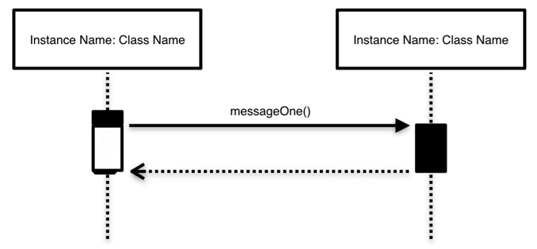
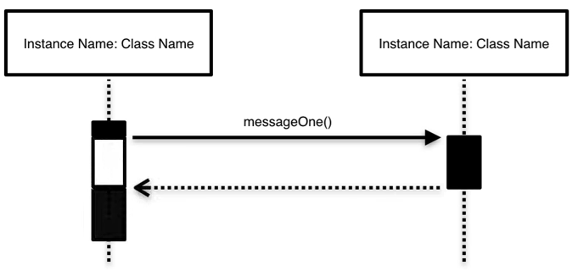
Different parts of SEQUENCE Diagram
Focus of Control:
  The focus of control indicates times during activation when processing is taking place within that object.
Waiting Time
Execution Time
Date: March 18, 2024
Software Engineering Design: Theory and Practice

Slide 21
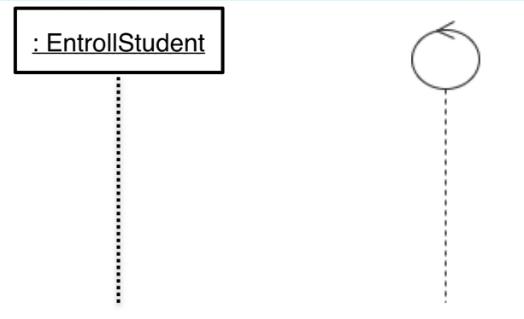
Different parts of SEQUENCE Diagram
Control Object:
  The control object is to manage the collaboration of objects which gives effect to the Use Case Process.
Date: March 18, 2024
Software Engineering Design: Theory and Practice

Slide 22
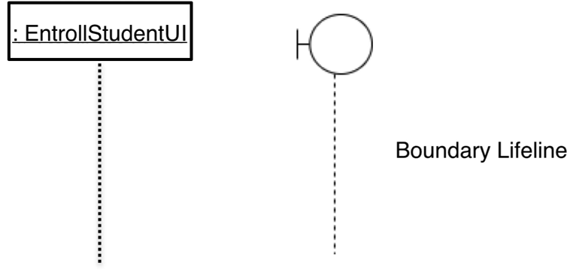
Different parts of SEQUENCE Diagram
Boundary Object:
  Most use cases imply at least one boundary object that manages the dialogue between the actor and the system.
Date: March 18, 2024
Software Engineering Design: Theory and Practice

Slide 23
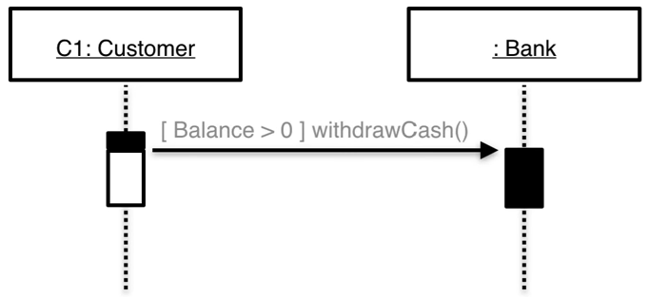
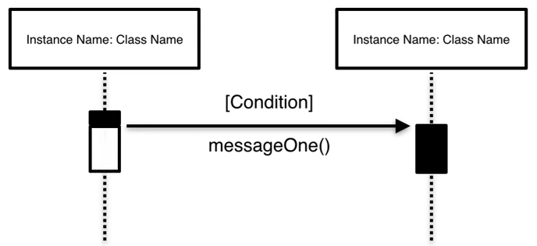
Different parts of SEQUENCE Diagram
Guards:
  When modeling object interactions, there may be a certain condition that must be met for a message to be sent to the object. To model conditions, like if condition in programming, we use guards in sequence diagrams.
Date: March 18, 2024
Software Engineering Design: Theory and Practice

Slide 24
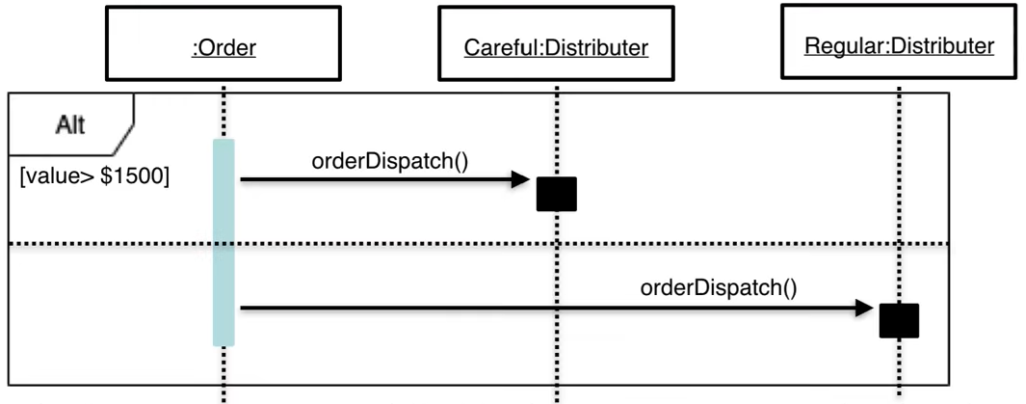
Different parts of SEQUENCE Diagram
Alternative:
  Alternative in sequence diagram symbolizes a choice between two or more message sequences. To model a choice of the message with a condition like if – else condition in programming, we use an alternative.
Date: March 18, 2024
Software Engineering Design: Theory and Practice

Slide 25
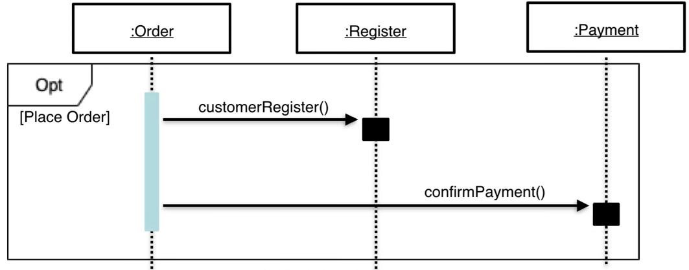
Different parts of SEQUENCE Diagram
Optional:
  Optional is similar to Guards where the fragment executes only if the supplied condition is true.
Date: March 18, 2024
Software Engineering Design: Theory and Practice

Slide 26
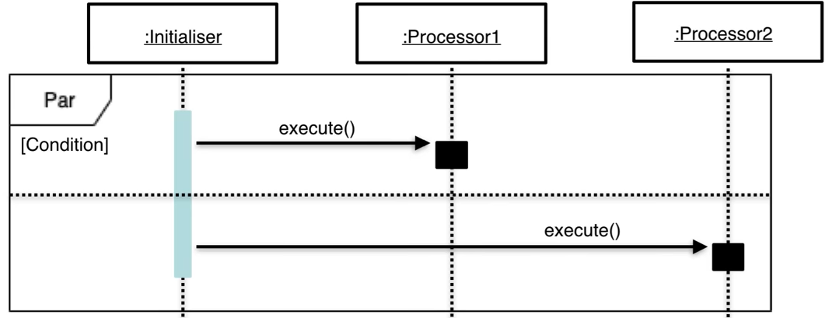
Different parts of SEQUENCE Diagram
Parallel:
  In parallel, each fragment is run in parallel. If the condition is match, each fragment or the message will execute parallel.
Date: March 18, 2024
Software Engineering Design: Theory and Practice

Slide 27
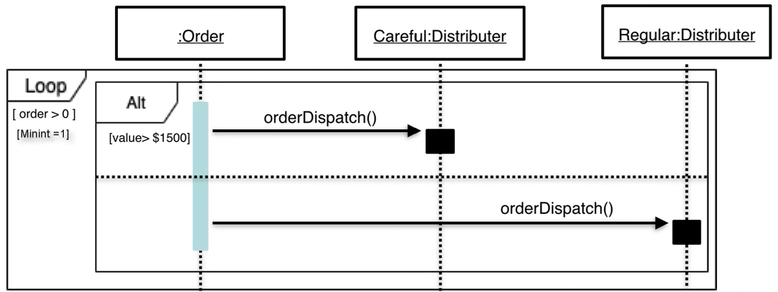
Different parts of SEQUENCE Diagram
Loops:
  The fragment may execute multiple times which may be need to model in a diagram. Loops fragment is used to represent a repetitive sequence and it is very similar in appearance to the optional.
Date: March 18, 2024
Software Engineering Design: Theory and Practice

Slide 28
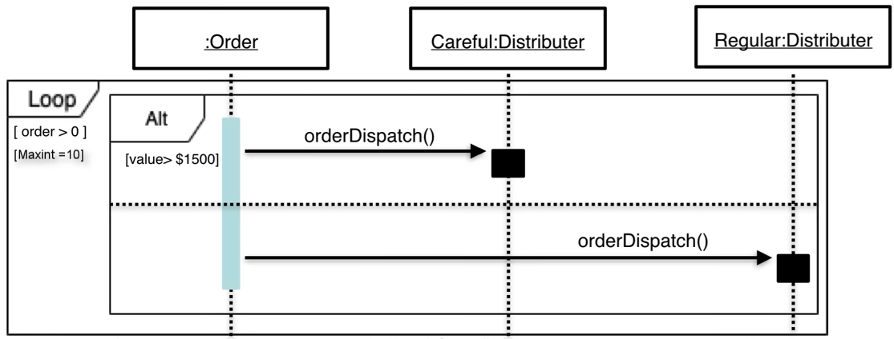
Different parts of SEQUENCE Diagram
Date: March 18, 2024
Software Engineering Design: Theory and Practice

Slide 29
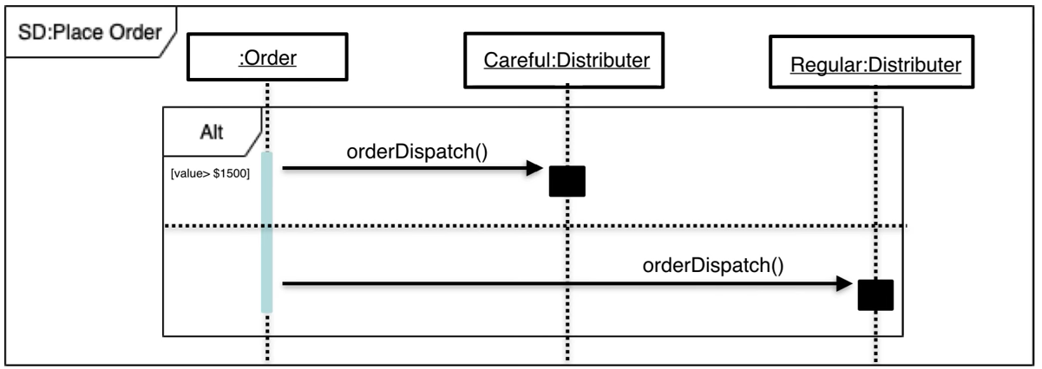
Different parts of SEQUENCE Diagram
Sequence Diagram:
  The entire sequence diagram is surround by the box or frame and inside the frame’s name, label with text sd:Process Name.
Date: March 18, 2024
Software Engineering Design: Theory and Practice

Slide 30
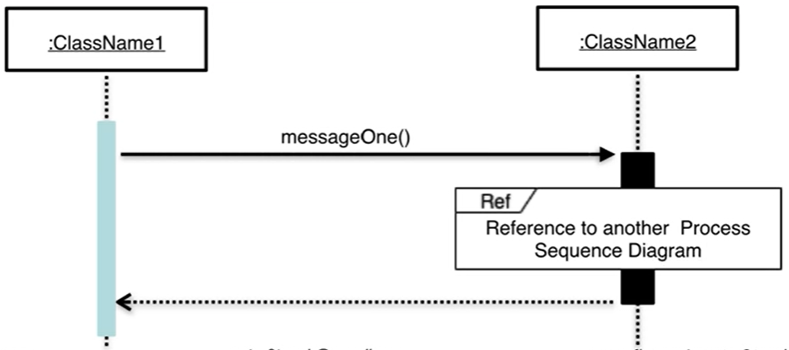
Different parts of SEQUENCE Diagram
  Beside these, there are other notation like
  Negative: The fragment shows an invalid interaction.
  Reference: refers to an interaction defined on another diagram. The frame is drawn to cover the lifelines involved in the interaction. You can define parameters and a return value.
Date: March 18, 2024
Software Engineering Design: Theory and Practice

Slide 31
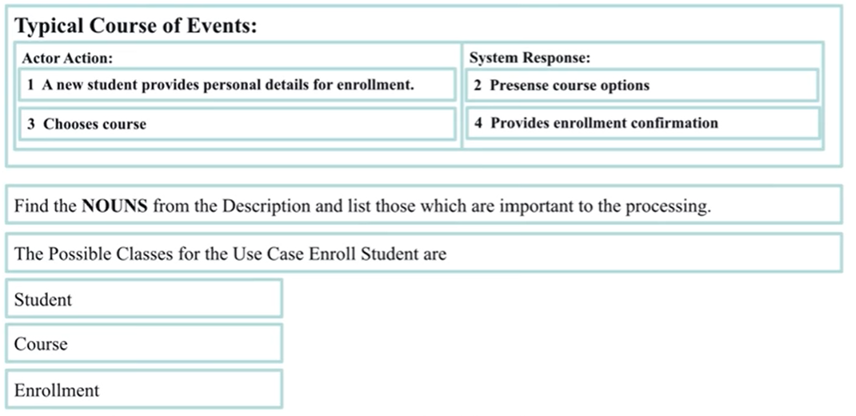
How to Draw a Sequence Diagram
1
Find the Domain Classes
Date: March 18, 2024
Software Engineering Design: Theory and Practice

Slide 32
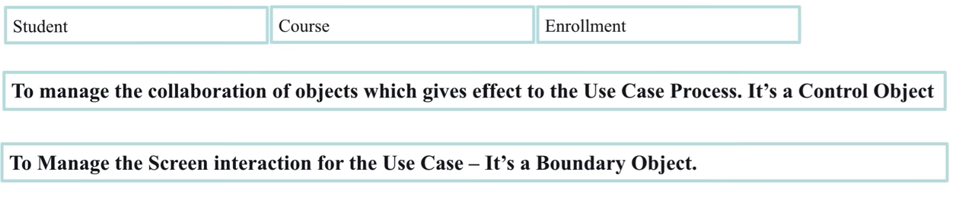
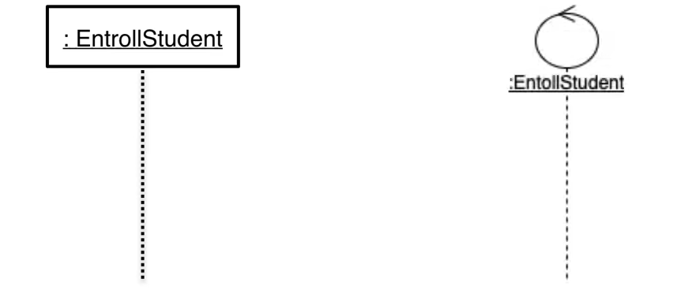
How to Draw a Sequence Diagram
2
Control Object Lifeline
Date: March 18, 2024
Software Engineering Design: Theory and Practice

Slide 33
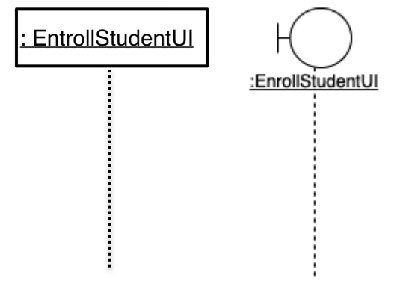
How to Draw a Sequence Diagram
3
Boundary Object Lifeline
Date: March 18, 2024
Software Engineering Design: Theory and Practice

Slide 34
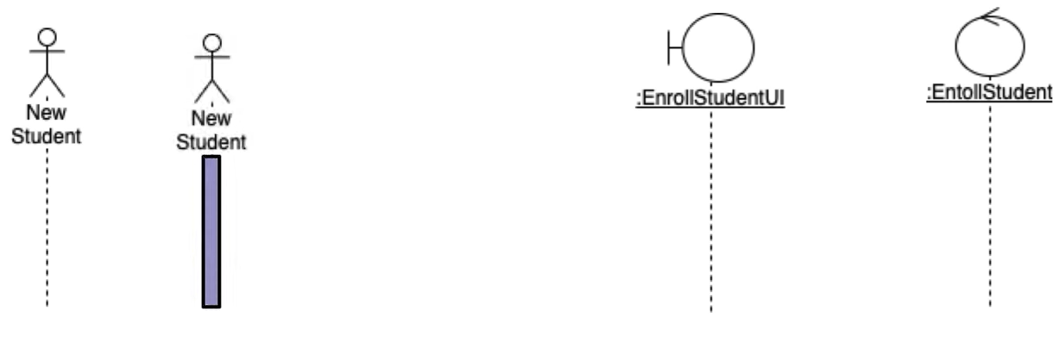
How to Draw a Sequence Diagram
4
Actor Lifeline
Date: March 18, 2024
Software Engineering Design: Theory and Practice

Slide 35
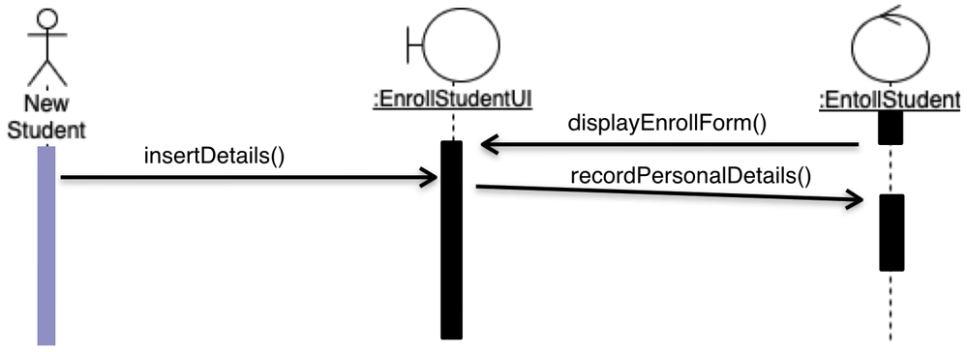
How to Draw a Sequence Diagram
5
Adding Messages
Date: March 18, 2024
Software Engineering Design: Theory and Practice

Slide 36
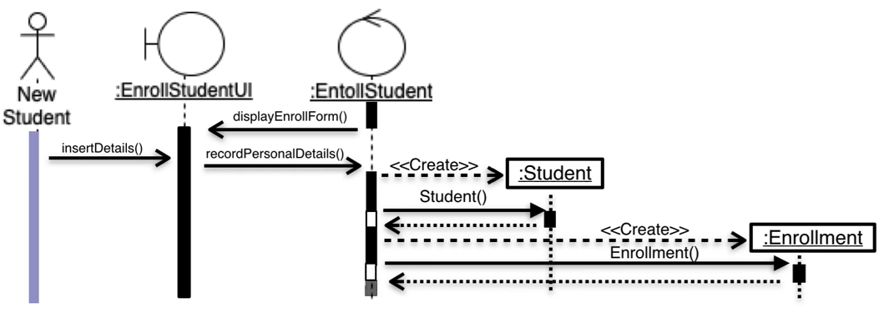
How to Draw a Sequence Diagram
6
Draw Object Lifeline
Date: March 18, 2024
Software Engineering Design: Theory and Practice

Slide 37
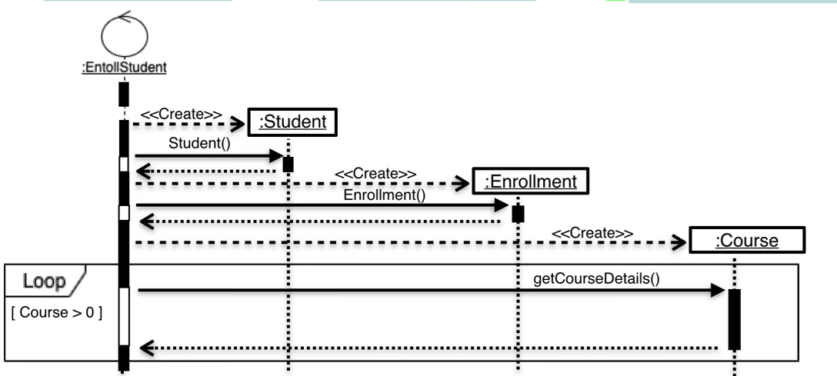
How to Draw a Sequence Diagram
Date: March 18, 2024
Software Engineering Design: Theory and Practice

Slide 38
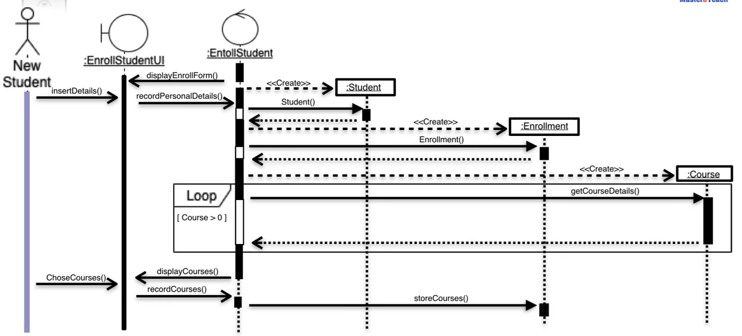
How to Draw a Sequence Diagram
Date: March 18, 2024
Software Engineering Design: Theory and Practice

Slide 39
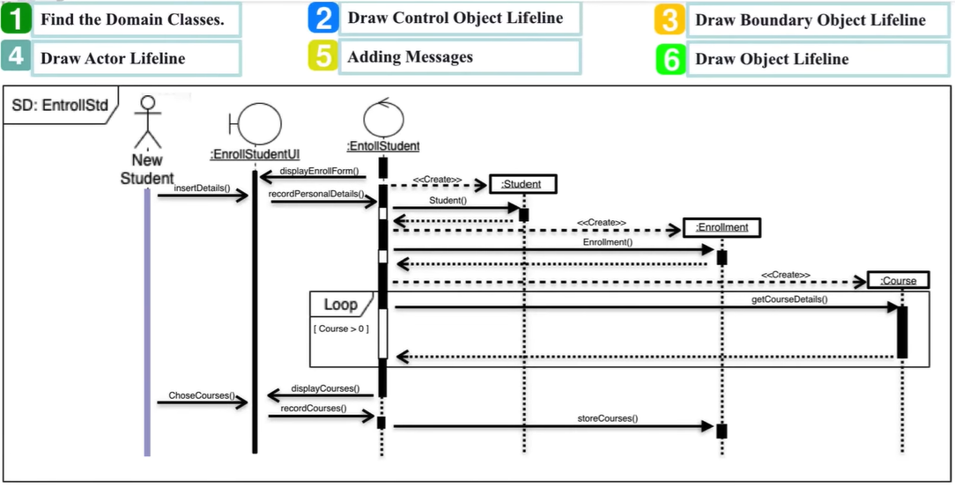
How to Draw a Sequence Diagram
Date: March 18, 2024
Software Engineering Design: Theory and Practice

Slide 40
References
https://creately.com/guides/sequence-diagram-tutorial/
https://robhosking.com/14-sequence-diagram-activity-diagram/
Date: March 18, 2024
Software Engineering Design: Theory and Practice

Slide 41
Thank You...
Mr. Ahsan Arif
Lecturer (Dept. of Software Engineering)
ahsanarif.se42@gmail.com

